Slide 1


CURBSIDE RECYCLING GUIDELINES
.
City of Huntsville Solid Waste and
Recycling Department

Slide 2
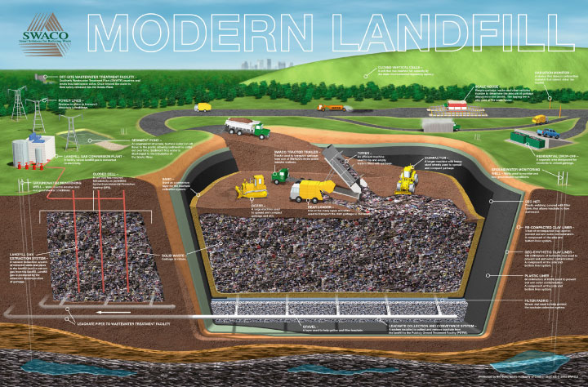
Curbside Recycling
Landfill Reduction

Slide 3
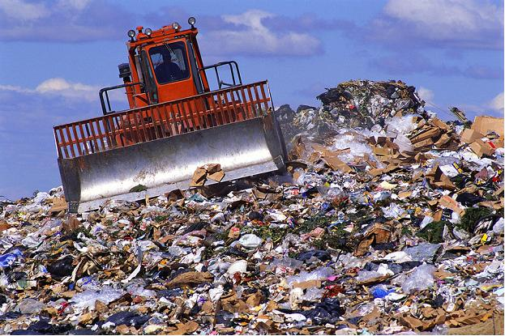
In fiscal year 2016, the City of Huntsville transferred 40,342.37 Tons (80,648,740Lbs.) of
garbage to the landfill.
The average person in our region produces 8 pounds of trash daily.
That’s 8.2 million tons of trash from our region in one year!
Up to 70% of this trash is buried in the landfill.

Slide 4
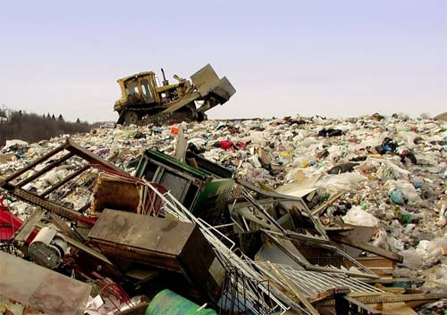
Recycling is one of the most important actions you can take. Only about 1/10th of garbage gets recycled but OVER HALF could be. ~ HGAC

Slide 5
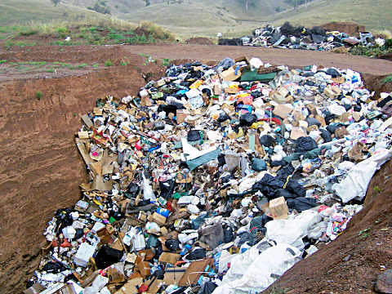
How long does it take for items to breakdown (biodegrade) in the landfill?
Plastic Bottles 1 Million Years
Glass 1 Million Years
Aluminum Cans 50 to 200 Years
Paper 1 to 5 months
Disposable Diapers 500 years
Batteries 100 years

Slide 6
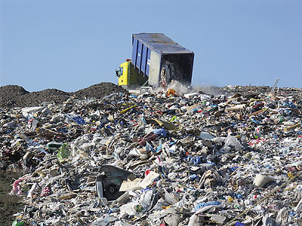
Instead of burying recyclable items in the landfill, these items can be processed for reuse. The items are sorted, broken down and put back into circulation.
With your help,
the City of Huntsville
is making every
effort to reduce,
reuse and recycle.

Slide 7
BLUE Recycling Carts
Only acceptable recycling items can be placed inside the BLUE cart.

Slide 8

Acceptable Items to be Placed in Your Blue Cart
Small Cardboard Boxes
Aluminum Cans
Newspaper
Steel Cans
Office Paper
Magazines
Plastics #1 thru #7

Slide 9

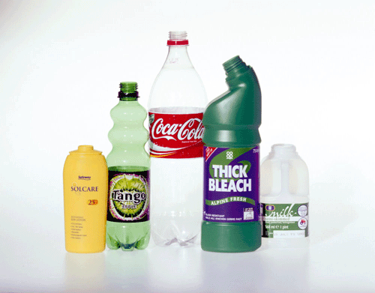
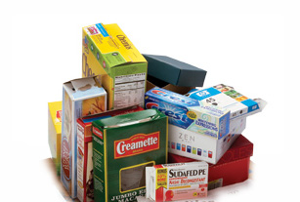
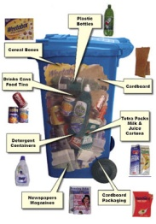
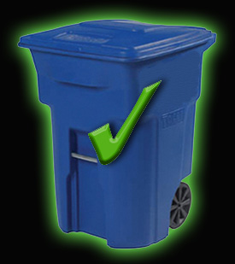
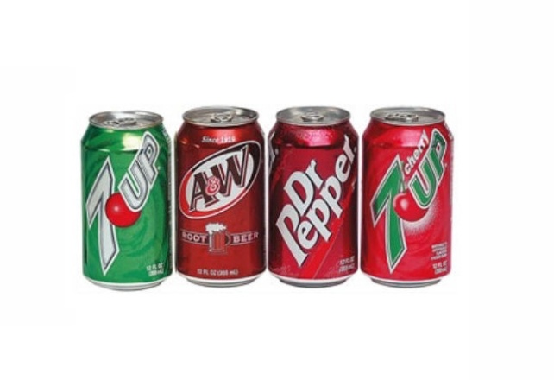
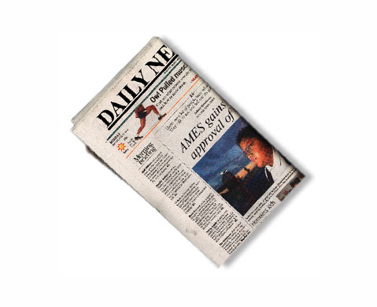
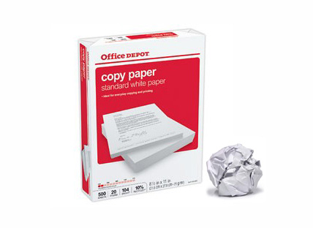
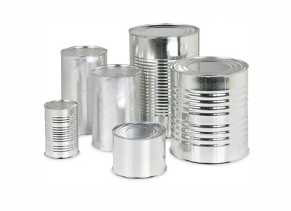
YES! Blue Cart
Plastics #1 thru #7

Slide 10

Unacceptable Items that Cannot be Placed in Your Blue Cart
The following items are either too bulky, unsuitable for processing or too dangerous for curbside collection:
Garbage
Aluminum Foil
Appliances
Toys
Batteries
Hangers
Cell Phones
Styrofoam
Large Cardboard
Electronics
GLASS
______ (of ANY kind)
Loose Shredded Paper
Plastics other than #1 thru #7
Film Plastic, Plastic Bags

Slide 11
Unacceptable Items that Cannot be Placed in Your Blue Cart
Although these items can’t be placed into your BLUE recycling cart, they can still be dropped off at the City’s Recycling Center located at 590 I-45 North.
Large/bulky Cardboard:
Any cardboard that doesn’t fit loosely into your BLUE cart. Large boxes such as moving, refrigerator and TV boxes.
GLASS:
Brown, Green, and Clear glass only. NO glass panes.
VEHICLE OIL, VEHICLE OIL FILTERS, ANTIFREEZE, AND COOKING OIL

Slide 12
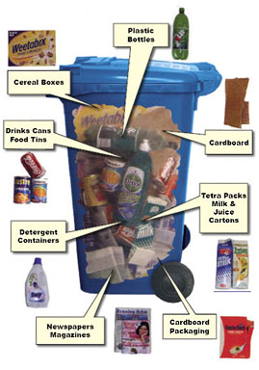
Preparing Items for Recycling
Acceptable recycling items are loosely placed in the BLUE recycling cart
Plastic Bags - Please do not place recycling items into plastic bags. During processing it is more time consuming to remove them from these bags.
Paper Bags – These can be used to separate paper items.

Slide 13
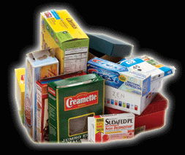
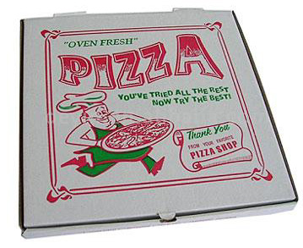
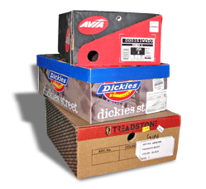
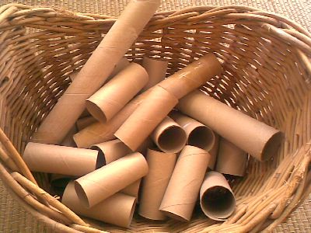
Preparing Items for Recycling
Small cardboard boxes – Include any small cardboard items that will fit loosely into your Blue cart:
Food boxes
Pizza Boxes-must be clean
And grease free
Medicine boxes
Shoe boxes
Toilet paper rolls
Paper towel rolls

Slide 14
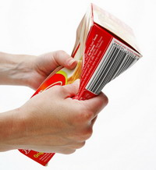
These should be empty, broken down and flattened in order to save space in your BLUE cart.

Slide 15
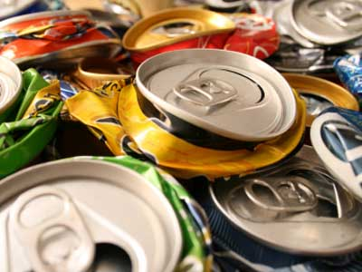
Preparing Items for Recycling
Aluminum cans
These should be rinsed and then flattened in order to save space in your BLUE cart.

Slide 16
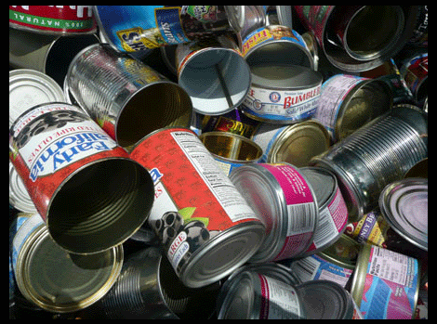
Preparing Items for Recycling
Steel cans – Canned foods
These should be rinsed and the lids must be thrown away before placing them into your BLUE cart. Removing the wrapper is very helpful but not necessary.

Slide 17
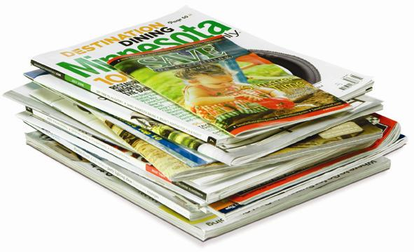

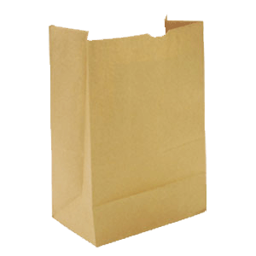
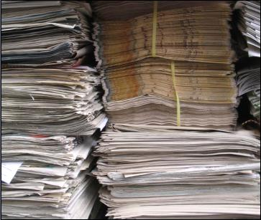
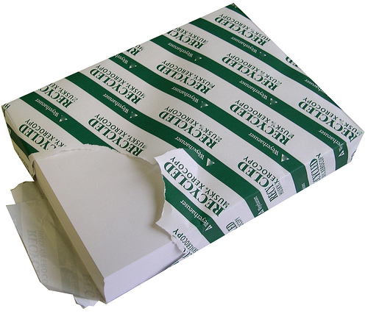

Preparing Items for Recycling
Office Paper – White and colored paper
Newspaper
Magazines
These items can be bagged in PAPER bags before placing them into the BLUE cart.

Slide 18

Preparing Items for Recycling
Plastics – Numbered 1, 2, 3, 4, 5, 6 & 7 are acceptable, NO Styrofoam. 80% of all plastic containers from the grocery store are recyclable. Look for these symbols:
These symbols are usually located on the bottom portion of your recyclable plastics. Any plastic matching any one of these symbols can be placed in the BLUE cart for recycling.

Slide 19

Preparing Items for Recycling
These should be rinsed and the lid thrown away before placing them into your BLUE cart. Removing the wrapper is very helpful but not necessary.

Slide 20
BLUE Cart setting out for pickup
The BLUE recycling cart must be at the street’s edge by 6:00 AM on your scheduled collection days. You may set your cart out as early as 8:00 PM the evening before.
Keep your recycling cart five feet away from all obstacles such as parked cars, mailboxes, telephone boxes, water meters, fences and walls.
Your recyclables must fit easily into your BLUE cart. The lid of your cart must be closed to prevent spillage.
Don’t forget to remove your recycling cart from the street’s edge after pickup on your collection days.
The cart should be placed in the same manner and position as your trash cart BUT only on your scheduled recycling days.

Slide 21



Thank you…
Remember the three R’s:
REDUCE – the amount of products you use.
REUSE – a product instead of throwing it away.
RECYCLE – products whenever you can.

Slide 22
What’s the #1 Question we get?

Slide 23
Is the City making money off of the Citizens of Huntsville?
Curbside Recycling for the City of Huntsville | Revenue Received from Recycling Vendor | # of Tons Hauled for That Month | # of Loads | Cost of Hauling | Cost Difference
October-14 | $ 17.21 | 19.31 | 2 | $ 2,050.00 | $ (2,032.79)
November-14 | $ 48.66 | 0 | 0 | $ 0.00 | $ 48.66
December-14 | $ - | 31.51 | 3 | $ 2,025.00 | $ (2,025.00)
January-15 | $ (140.56) | 28.61 | 3 | $ 2,025.00 | $ (2,165.56)
February-15 | $ (313.96) | 32.69 | 4 | $ 2,700.00 | $ (3,013.96)
March-15 | $ (774.26) | 36.61 | 4 | $ 2,700.00 | $ (3,474.26)
April-15 | $ (640.84) | 33.25 | 3 | $ 2,025.00 | $ (2,665.84)
May-15 | $ (618.74) | 40.86 | 4 | $ 2,700.00 | $ (3,318.74)
June-15 | $ (567.06) | 28.39 | 3 | $ 2,025.00 | $ (2,592.06)
July-15 | $ (375.88) | 43.96 | 5 | $ 3,375.00 | $ (3,750.88)
August-15 | $ (567.72) | 38.4 | 4 | $ 2,700.00 | $ (3,267.72)
September-15 | $ (576.98) | 35.61 | 4 | $ 2,700.00 | $ (3,276.98)
REVENUE FY 2015 | $ (4,510.13) | 369.2 | 39 | $ 27,025.00 | $ (31,535.13)
October-15 | $ (734.31) | 34.99 | 4 | $ 2,700.00 | $ (3,434.31)
November-15 | $ (738.21) | 10.87 | 1 | $ 675.00 | $ (1,413.21)
December-15 | $ (221.22) | 31.89 | 3 | $ 2,025.00 | $ (2,246.22)
January-16 | $ (692.84) | 37.73 | 4 | $ 2,700.00 | $ (3,392.84)
February-16 | $ (914.90) | 33.66 | 4 | $ 2,700.00 | $ (3,614.90)
March-16 | $ (903.65) | 19.74 | 2 | $ 1,350.00 | $ (2,928.65)
April-16 | $ (583.79) | 44.19 | 4 | $ 2,700.00 | $ (3,283.79)
May-16 | $ (1,009.82) | 26.39 | 4 | $ 2,700.00 | $ (3,709.82)
June-16 | $ (528.63) | 42.98 | 4 | $ 2,700.00 | $ (3,228.63)
July-16 | $ (411.74) | 46.24 | 5 | $ 3,375.00 | $ (3,786.74)
August-16 | $ (432.99) | 35.54 | 4 | $ 2,700.00 | $ (3,131.99)
September-16 | $ (285.86) | 44.22 | 5 | $ 3,375.00 | $ (3,660.86)
REVENUE FY 2016 | $ (7,456.96) | 420.96 | 44 | $ 29,700.00 | $ (37,156.96)
Totals | $ (11,967.09) | 790.16 | 83 | $ 56,725.00 | $ (68,692.09)

