Slide 1
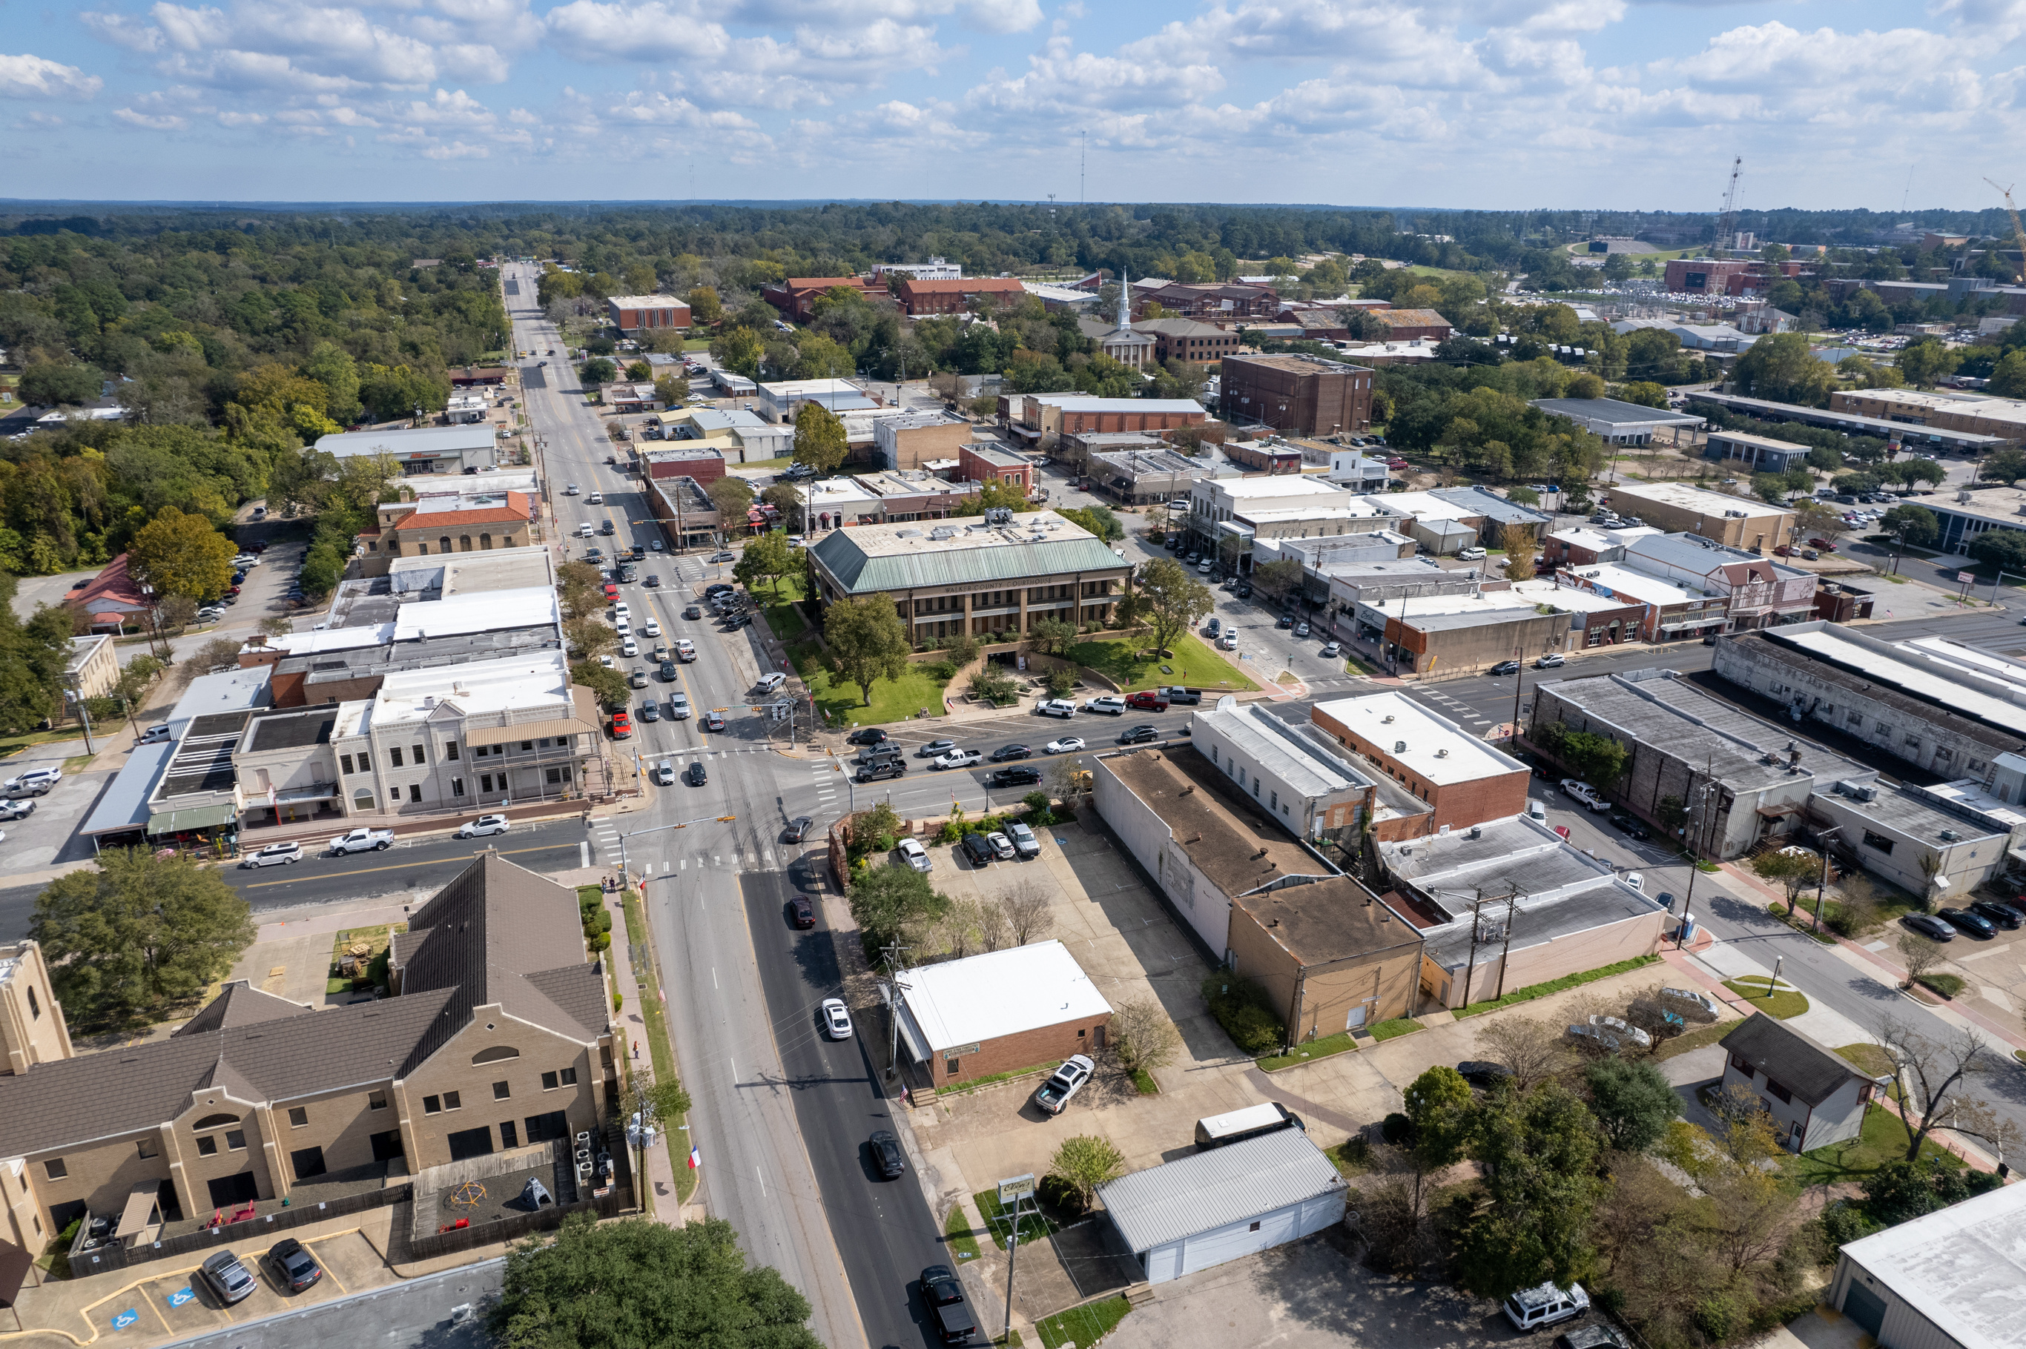
2024
Strategic Plan
Implementation Plan

Slide 2

Service: Commit to helping others and provide the highest quality of life for our community
Trust: Be transparent, honest and truthful in all our interactions, building confidence in what we deliver.
Accountability: Take ownership in what we do.
Respect: Value everyone and ensure that we demonstrate it in all our actions

Slide 3
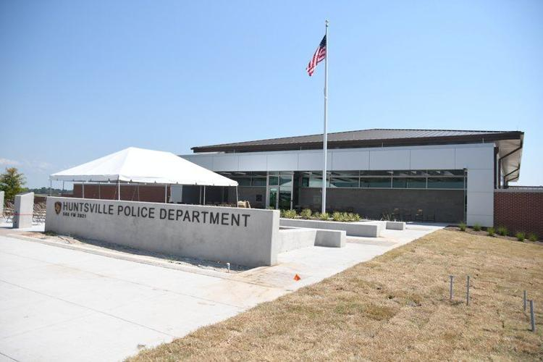
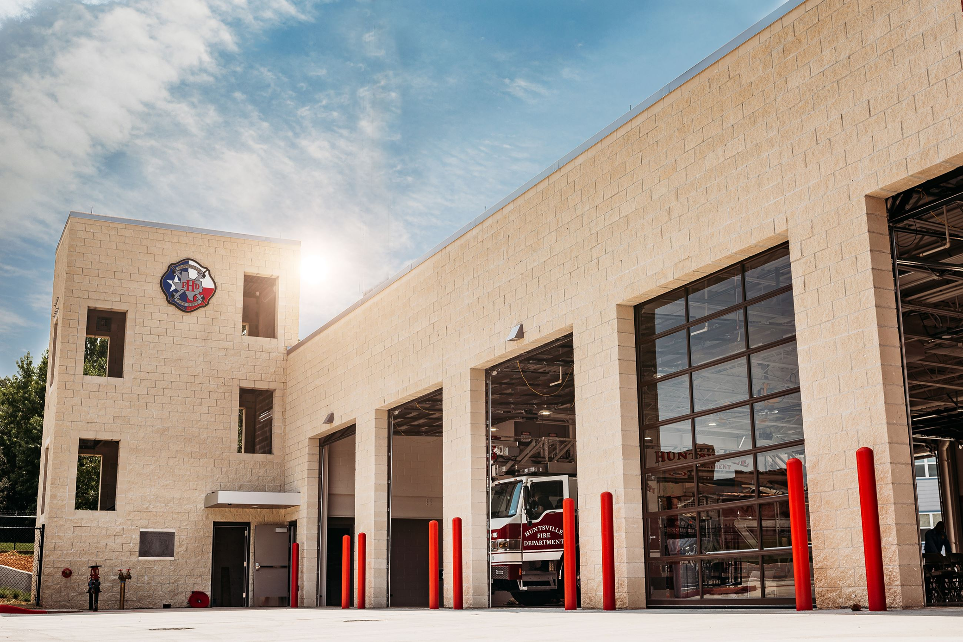
Strategic Priority #1
Public Safety
Create a community where all individuals feel safe and protected, where citizens trust the effectiveness of our agencies through community engagement, technologies, and best practices. We strive to promote a culture of service, prevention and partnership.

Slide 4

Provide increased public safety staffing levels to further advance alignment with recognized national standards | Provide increased public safety staffing levels to further advance alignment with recognized national standards | Provide increased public safety staffing levels to further advance alignment with recognized national standards
[✓] Metric 1: Assess staffing levels for police and fire
[ ] Nationally recognized standard for PD is 85 police officers (based on population) Huntsville: 80%
[ ] Nationally recognized standard for FD is 55 (based on area, response times, etc.) Huntsville: 56%
66% Complete

Slide 5

Complete application for the Texas Fire Chief’s Recommendation program for Best Practices | Complete application for the Texas Fire Chief’s Recommendation program for Best Practices | Complete application for the Texas Fire Chief’s Recommendation program for Best Practices
[✓] Metric 1: Assign internal project manager to oversee application.
[✓] Metric 2: Work towards achieving compliance. (98%)
[✓] Metric 3: Submit draft documentation for internal review.
[ ] Metric 4: Submit completed application.
75% Complete

Slide 6

Continue public safety personnel participation in community events to include fire prevention and community safety activities | Continue public safety personnel participation in community events to include fire prevention and community safety activities | Continue public safety personnel participation in community events to include fire prevention and community safety activities
[✓] Metric 1: Establish annual event participation calendar.
[✓] Metric 2: Maintain public safety presence throughout the calendar year.
[✓] Metric 3: Track number of participants engaged at each event.
100% Complete

Slide 7
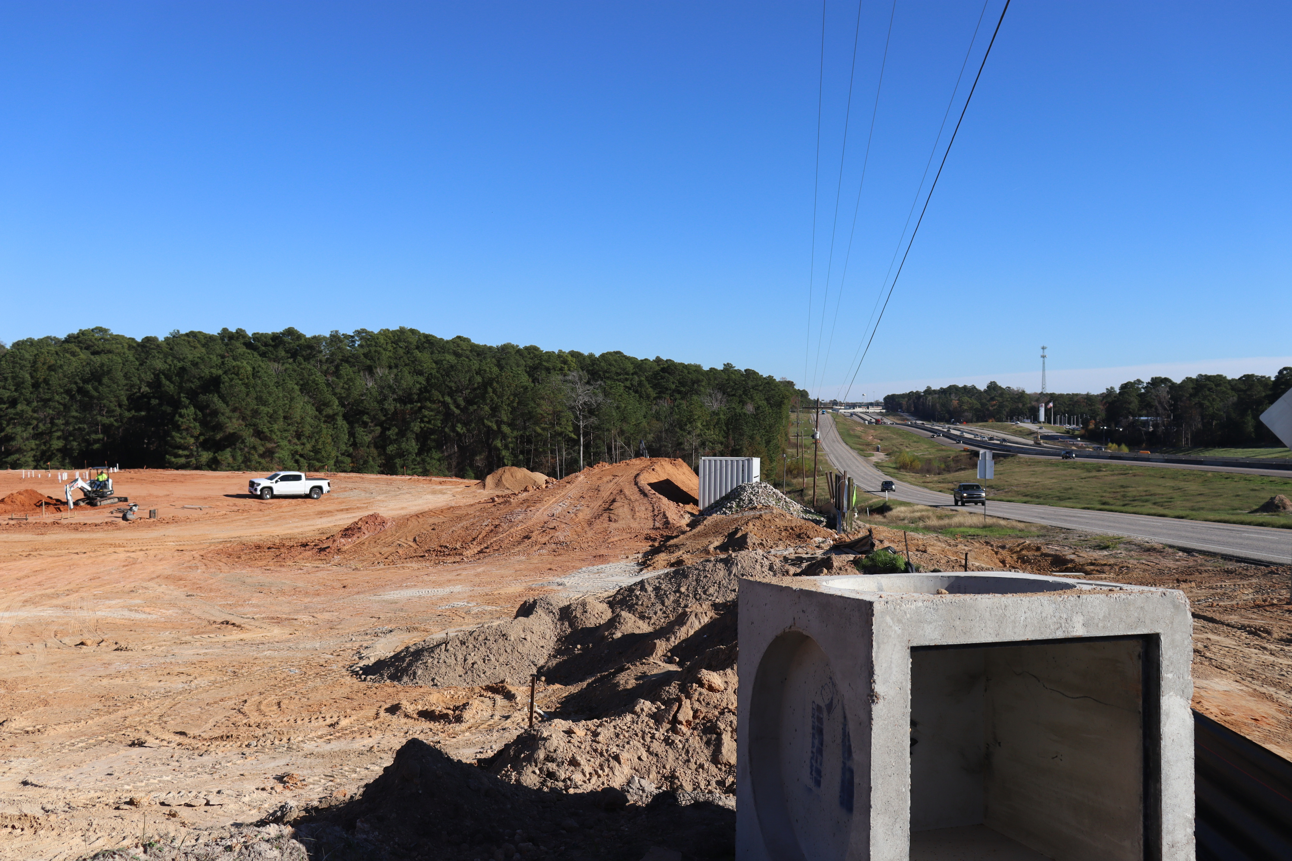
Strategic Priority#2
Economic Development
Create an economic climate for the City of Huntsville that drives development of diverse industries and sectors, providing sustainable economic growth and improved living standards.

Slide 8
Aggressively pursue future economic development activities of the City of Huntsville | Aggressively pursue future economic development activities of the City of Huntsville | Aggressively pursue future economic development activities of the City of Huntsville
[✓] Metric 1: Continue to implement the 2040 Comprehensive Plan.
[✓] Metric 2: Elevate Huntsville’s profile to generate leads.
[✓] Metric 3: Track number of new leads, projects, and business expansions.
[✓] Metric 4: Continue to maintain and foster strategic partnerships.
100% Complete

Slide 9
Complete the downtown strategies plan and consider recommendations for implementation | Complete the downtown strategies plan and consider recommendations for implementation | Complete the downtown strategies plan and consider recommendations for implementation
[✓] Metric 1: Complete draft Downtown Strategies Plan.
[✓] Metric 2: Present plan to Council.
[✓] Metric 3: Finalize and implement plan.
100% Complete

Slide 10
Continue implementation of the 2020 adopted Airport Master Plan to include runway improvements and the support of additional private investment in facilities | Continue implementation of the 2020 adopted Airport Master Plan to include runway improvements and the support of additional private investment in facilities | Continue implementation of the 2020 adopted Airport Master Plan to include runway improvements and the support of additional private investment in facilities
[✓] Metric 1: Implement engineering and design plans for key airport infrastructure projects.
[✓] Metric 2: Secure and manage funding commitments for capital improvement projects.
[ ] Metric 3: Expand airport operational capacity
66% Complete

Slide 11
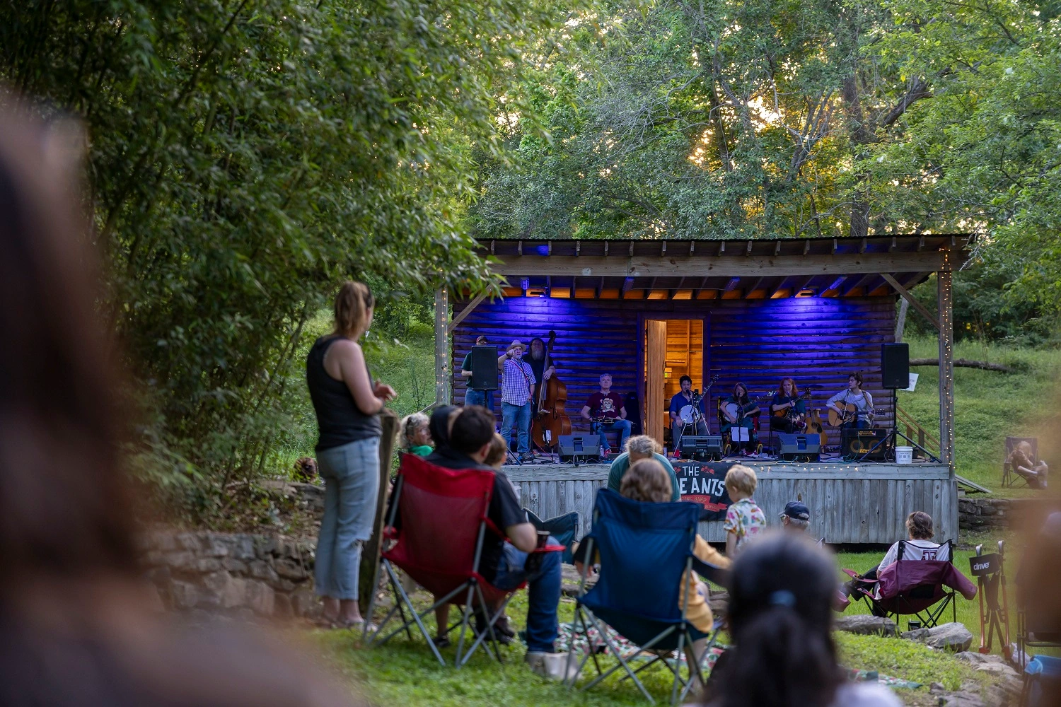
Strategic Priority#3
Quality of Life
Establish an environment where citizens can thrive and enjoy the city in which they live. Provide services that enhance the quality of life for all, with a focus on the full life cycle (children, students, families, and retirees)-by creating amenities that support physical, mental and social well-being. Support access to quality health services, education, housing, transportation, recreation and natural environment.

Slide 12
Consider amendments to the Development Code to include additional zoning districts | Consider amendments to the Development Code to include additional zoning districts | Consider amendments to the Development Code to include additional zoning districts
[✓] Metric 1: Identify needed zoning districts through stakeholder and staff input.
[✓] Metric 2: Draft proposed Development Code amendments.
[✓] Metric 3: Conduct public hearings and gather feedback.
[✓] Metric 4: Present final recommendations for Council adoption.
100% Complete

Slide 13
Complete the updates to the Parks Master Plan and review recommendations for implementation | Complete the updates to the Parks Master Plan and review recommendations for implementation | Complete the updates to the Parks Master Plan and review recommendations for implementation
[✓] Metric 1: Complete public engagement for Parks Master Plan update.
[✓] Metric 2: Draft and finalize updated Parks Master Plan.
[✓] Metric 3: Present plan to Council for adoption.
[✓] Metric 4: Identify top projects for implementation.
100% Complete

Slide 14

Enhance walkability through improvements identified in the transportation and parks master plans | Enhance walkability through improvements identified in the transportation and parks master plans | Enhance walkability through improvements identified in the transportation and parks master plans
[] Metric 1: Prioritize key walkability projects in Transportation and Parks Master Plan.
[ ] Metric 2: Complete design walkability improvements annually.
[] Metric 3: Secure funding for priority projects.
[ ] Metric 4: Construct and open new walkability amenities.
0% Complete

Slide 15
Review and consider policies and programs to assist in affordable housing development | Review and consider policies and programs to assist in affordable housing development | Review and consider policies and programs to assist in affordable housing development
[✓] Metric 1: Identify needed zoning districts through stakeholder and staff input.
[✓] Metric 2: Draft proposed Development Code amendments.
[✓] Metric 3: Conduct public hearings and gather feedback.
[✓] Metric 4: Present final recommendations for Council adoption.
100% Complete

Slide 16
Increase Code Enforcement efforts through enhanced enforcement of existing codes and ordinances | Increase Code Enforcement efforts through enhanced enforcement of existing codes and ordinances | Increase Code Enforcement efforts through enhanced enforcement of existing codes and ordinances
[✓] Metric 1: Audit current code enforcement caseload and performance.
[✓] Metric 2: Develop enhanced enforcement strategy with staffing needs.
[✓] Metric 3: Increase number of proactive inspections.
[✓] Metric 4: Track code compliance resolution rate quarterly.
100% Complete

Slide 17
Strategic Priority#4
Infrastructure
Develop and maintain a comprehensive and well-planned infrastructure network that prepares for the challenges of the future and provides quality, modern and efficient, water, wastewater, drainage and transportation services.

Slide 18
Continue to advance water and wastewater projects to ensure adequate capacity and reliability | Continue to advance water and wastewater projects to ensure adequate capacity and reliability | Continue to advance water and wastewater projects to ensure adequate capacity and reliability
[✓] Metric 1: Identify and prioritize water/wastewater capital projects.
[✓] Metric 2: Secure project funding
[✓] Metric 3: Complete construction milestones on schedule.
100% Complete

Slide 19
Complete the drainage fee study and implement recommendations to fund identified drainage improvements | Complete the drainage fee study and implement recommendations to fund identified drainage improvements | Complete the drainage fee study and implement recommendations to fund identified drainage improvements
[✓] Metric 1: Finalize and present drainage fee study to Council. (Presented to Council August 2024)
[✓] Metric 2: Adopt drainage fee structure. (Adopted by Council September 2024)
[✓] Metric 3: Establish dedicated drainage fund.
100% Complete

Slide 20
Identify and prioritize new roadway construction projects for potential placement on a future debt issuance | Identify and prioritize new roadway construction projects for potential placement on a future debt issuance | Identify and prioritize new roadway construction projects for potential placement on a future debt issuance
[✓] Metric 1: Conduct roadway needs assessment.
[✓] Metric 2: Prioritize projects.
[✓] Metric 3: Present project list for Council consideration.
[✓] Metric 4: Package projects into CIP Program
100% Complete

Slide 21

Complete construction of City Hall, consolidation of staff in the new facility, demolition of the old Service Center, and disposition of the current City Hall location (Old PD) | Complete construction of City Hall, consolidation of staff in the new facility, demolition of the old Service Center, and disposition of the current City Hall location (Old PD) | Complete construction of City Hall, consolidation of staff in the new facility, demolition of the old Service Center, and disposition of the current City Hall location (Old PD)
[ ] Metric 1: Complete City Hall construction to certificate of occupancy standards. (88% complete)
[ ] Metric 2: Move all departments into new facility.
[ ] Metric 3: Demolish old Service Center building.
[ ] Metric 4: Determine and execute disposition (sale, lease, repurpose, or demo) of current City Hall.
22% Complete

Slide 22
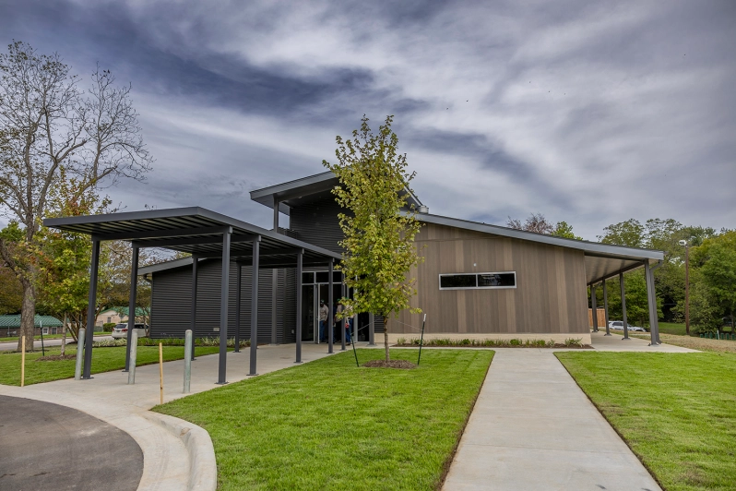
Strategic Priority#5
Engagement
Build strong relationships within our organization and community with a focus on our culture of core values as expressed in Service, Trust, Accountability and Respect. Provide a welcoming and collaborative environment that fosters mutual partnership between city government, community organizations and our residents.

Slide 23
Monitor and determine participation for inclusion in the HGAC Metropolitan Planning Organization (MPO) or other alternatives for future transportation planning | Monitor and determine participation for inclusion in the HGAC Metropolitan Planning Organization (MPO) or other alternatives for future transportation planning | Monitor and determine participation for inclusion in the HGAC Metropolitan Planning Organization (MPO) or other alternatives for future transportation planning
[ ] Metric 1: Collaborate with Walker County to determine an MPO within Walker County or the Houston-Galveston Area Council (HGAC)
[ ] Metric 2: Determine what is needed to successfully execute a Walker County MPO
[ ] Metric 3: Determine steps and requirements to join the HGAC MPO.
[ ] Metric 4: Utilize impact data to present options to the City Council and Walker County Commissioners Court
[ ] Metric 5: Ratify resolutions
0% Complete

Slide 24

Receive presentation on the impact of reaching 50,000 population and provide direction on preparing for the milestone | Receive presentation on the impact of reaching 50,000 population and provide direction on preparing for the milestone | Receive presentation on the impact of reaching 50,000 population and provide direction on preparing for the milestone
[✓] Metric 1: Schedule and hold the presentation for Council.
[ ]Metric 2: Council discusses and provides specific direction.
[ ]Metric 3: Staff develops action plan based on Council input.
33% Complete

Slide 25
Promote programs, such as the 311 system, through a variety of means to inform the public of our actions | Promote programs, such as the 311 system, through a variety of means to inform the public of our actions | Promote programs, such as the 311 system, through a variety of means to inform the public of our actions
[✓] Metric 1: Establish 311 Infrastructure and Carrier Services
[✓] Metric 2: Public Outreach
[✓] Metric 3: Maintain 311 Usage Reporting
100% Complete

Slide 26
Implement the STAR program with City employees to promote the core values adopted in the strategic plan | Implement the STAR program with City employees to promote the core values adopted in the strategic plan | Implement the STAR program with City employees to promote the core values adopted in the strategic plan
[✓] Metric 1: Develop STAR program materials and training. (Definitional Marketing- signage, challenge coins, recognition cards, etc.)
[✓] Metric 2: Conduct training sessions for new hires.
[✓] Metric 3: Recognize outstanding STAR employees quarterly.
[ ] Metric 4: Conduct engagement survey to gauge STAR program impact.
75% Complete

Slide 27
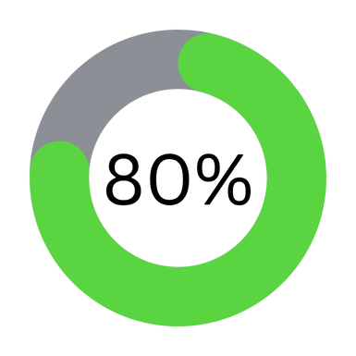
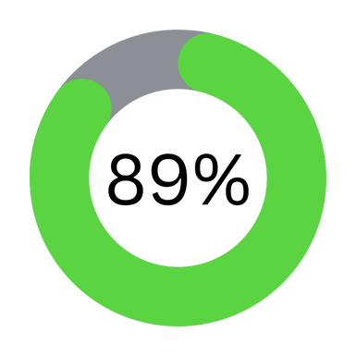
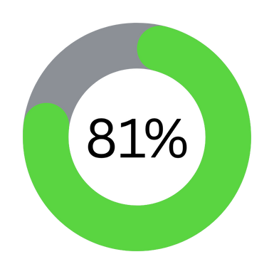
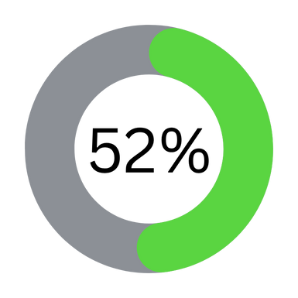
Overall Completion
Strategic Priority #1
Strategic Priority #2
Strategic Priority #3
Strategic Priority #4
Strategic Priority #5

Slide 28

Overall Completion
76% Complete
Strategic Plan 2024

