Slide 1
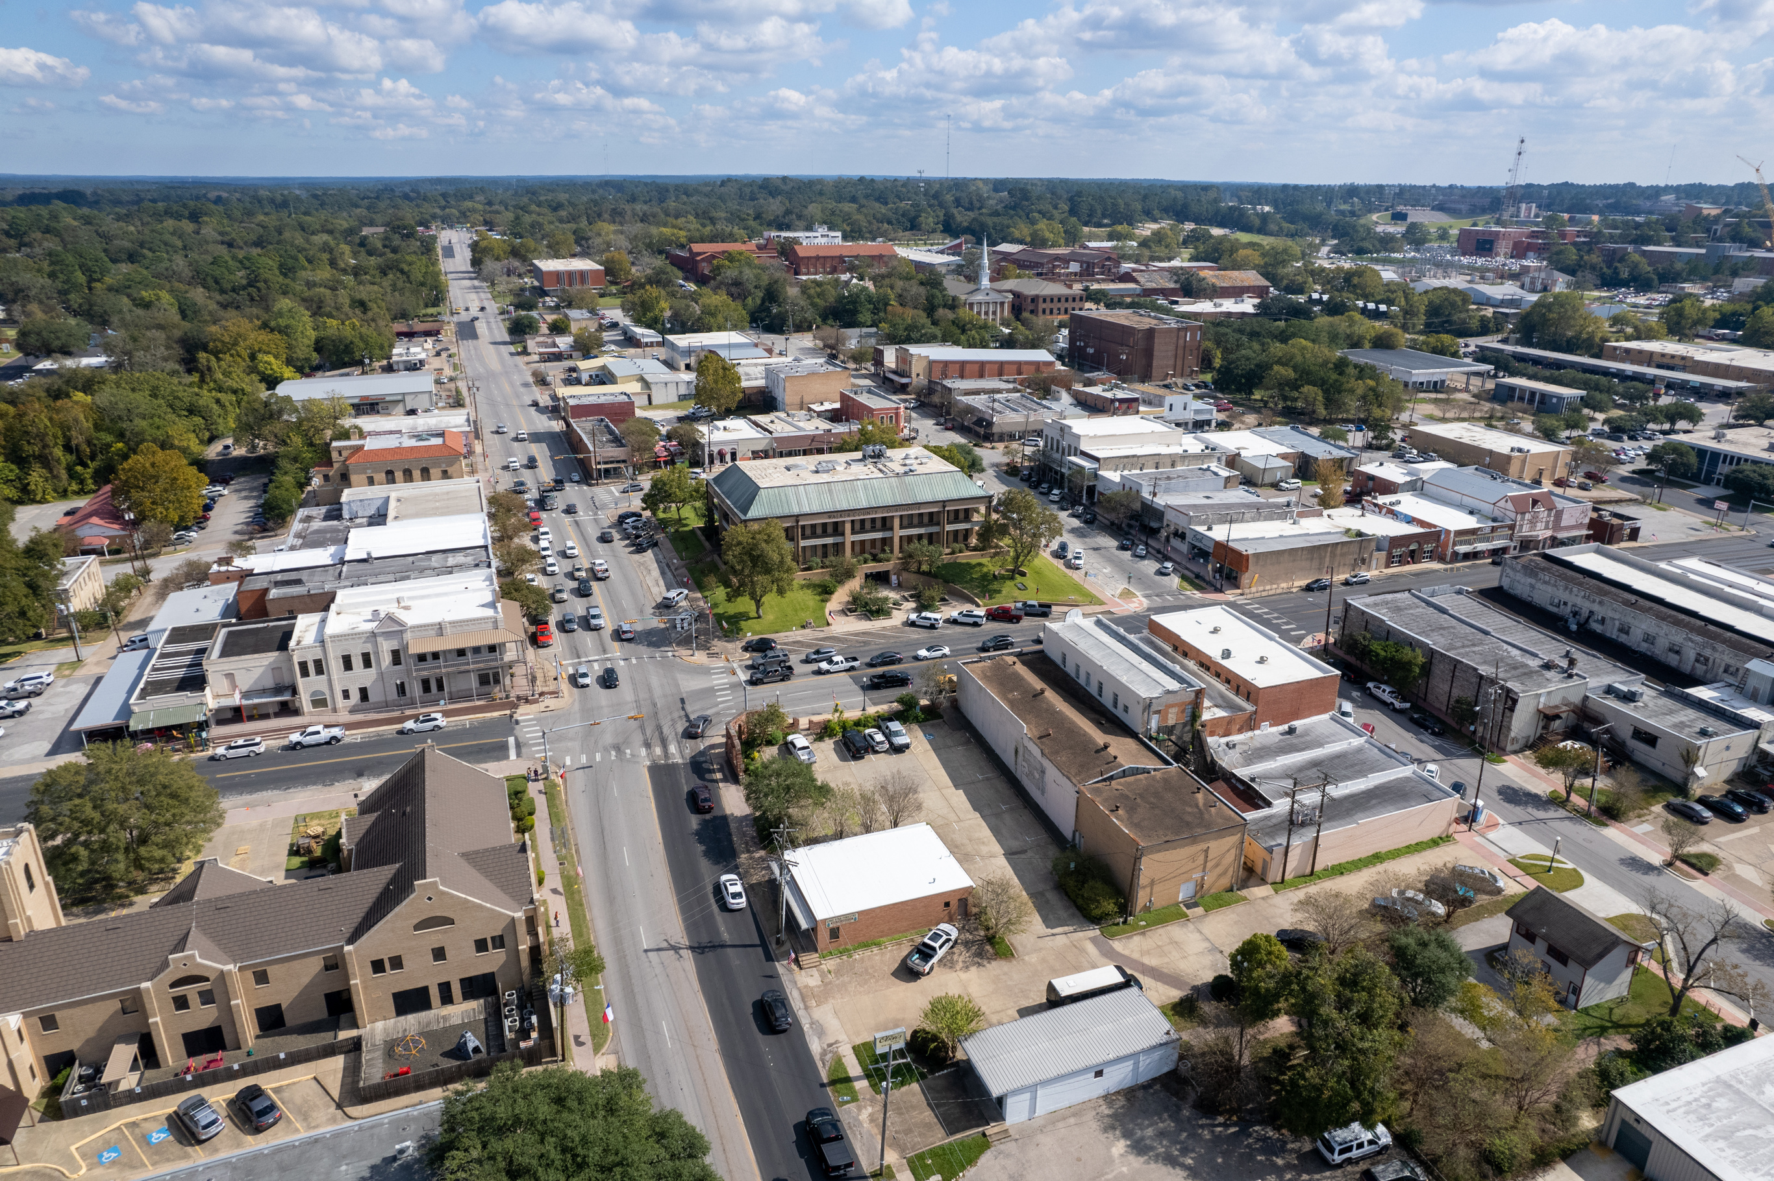

HUNTSVILLE STATE OF THE CITY
SAM MASIEL, INTERIM CITY MANAGER
HUNTSVILLE, TX
FEBRUARY 25, 2025

Slide 2
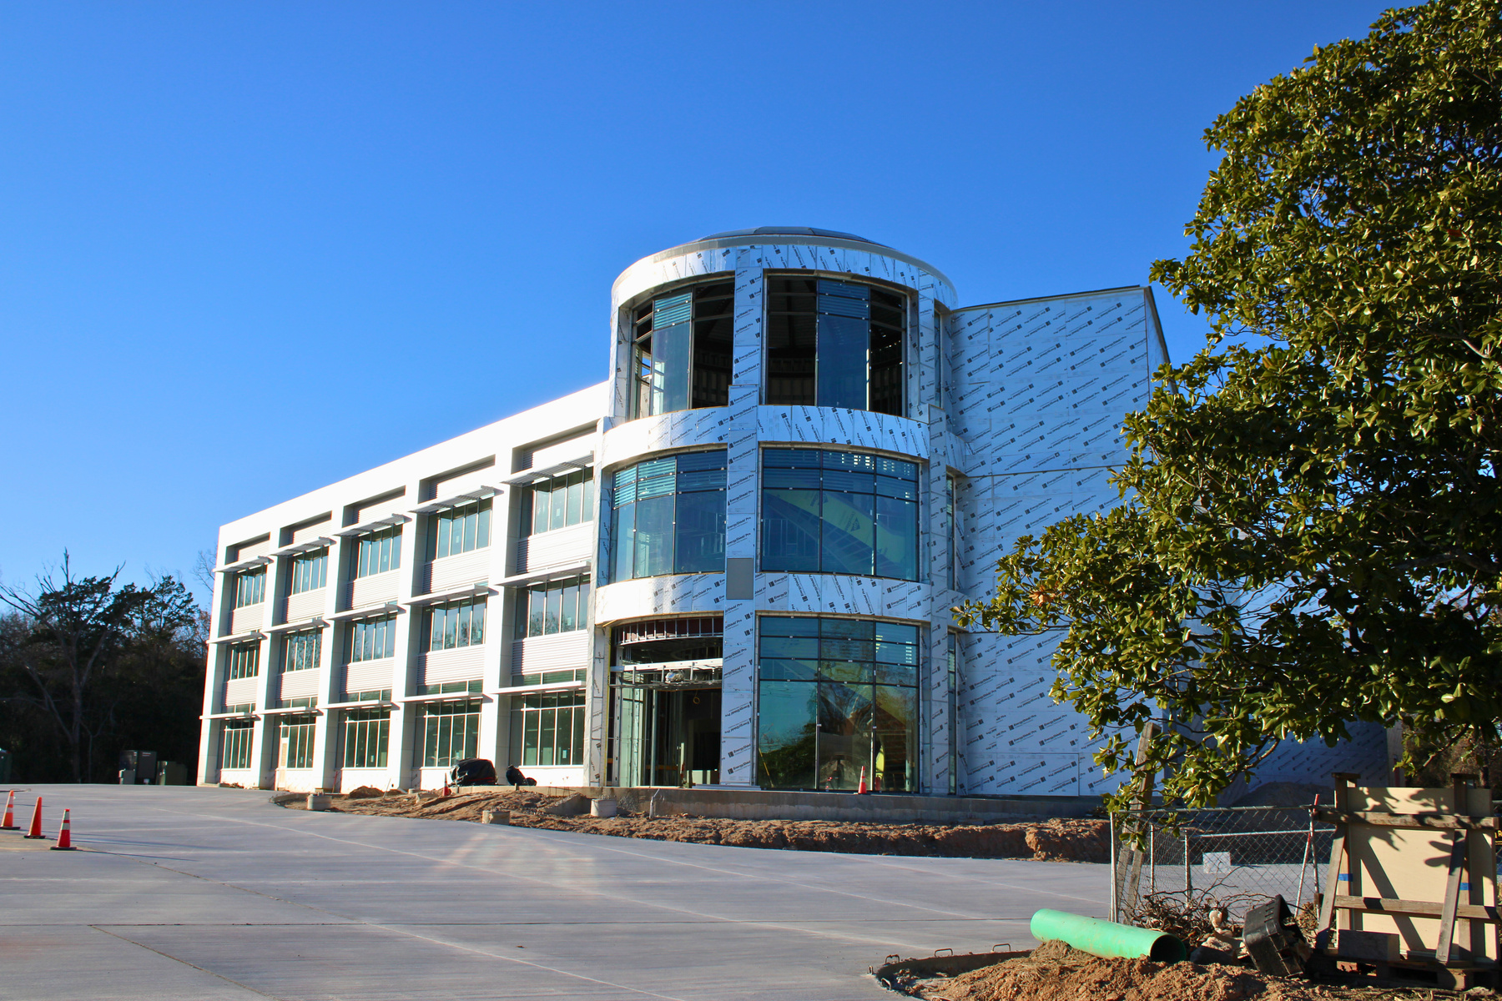
PUBLIC
PROJECTS

Slide 3
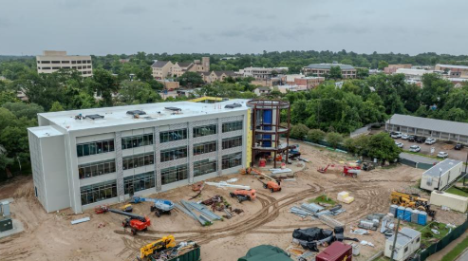
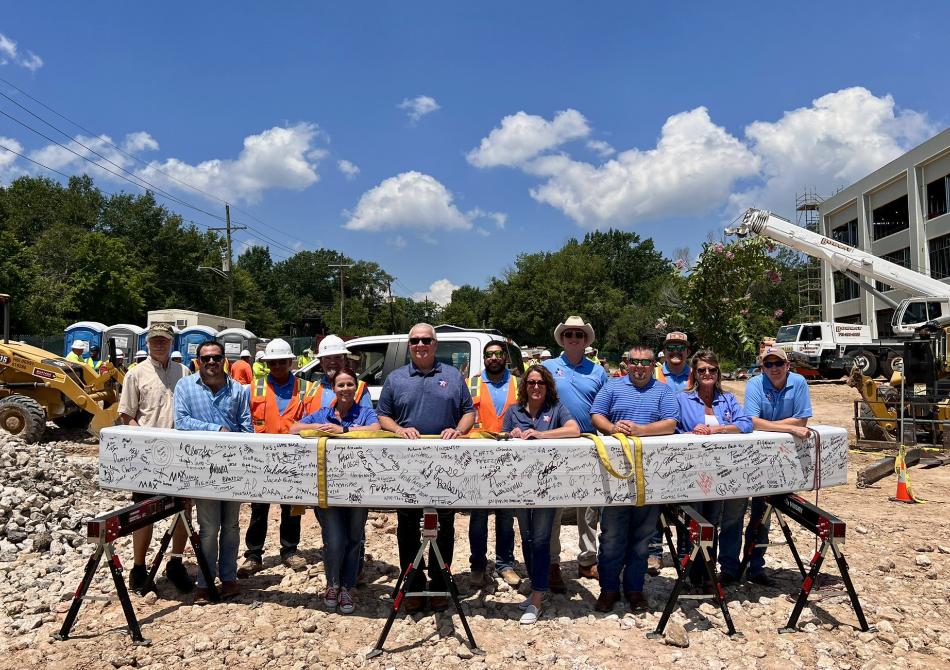
NEW CITY HALL
START DATE:
May 2023
ESTIMATED COMPLETION:
May 2025
COST:
$ 27,573,156

Slide 4
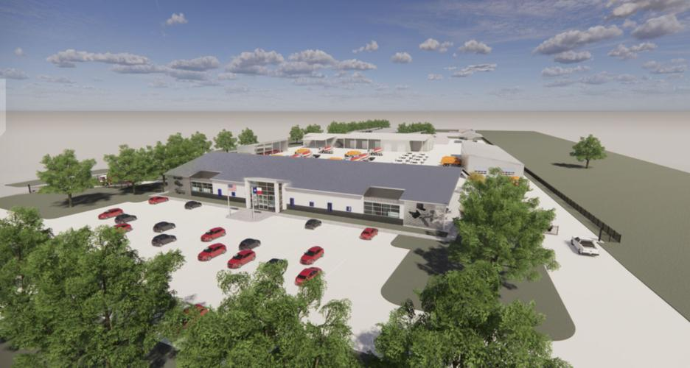
SERVICE CENTER
START DATE:
MARCH 2022
COMPLETION:
JANUARY 2024
COST:
$ 10,758,136

Slide 5
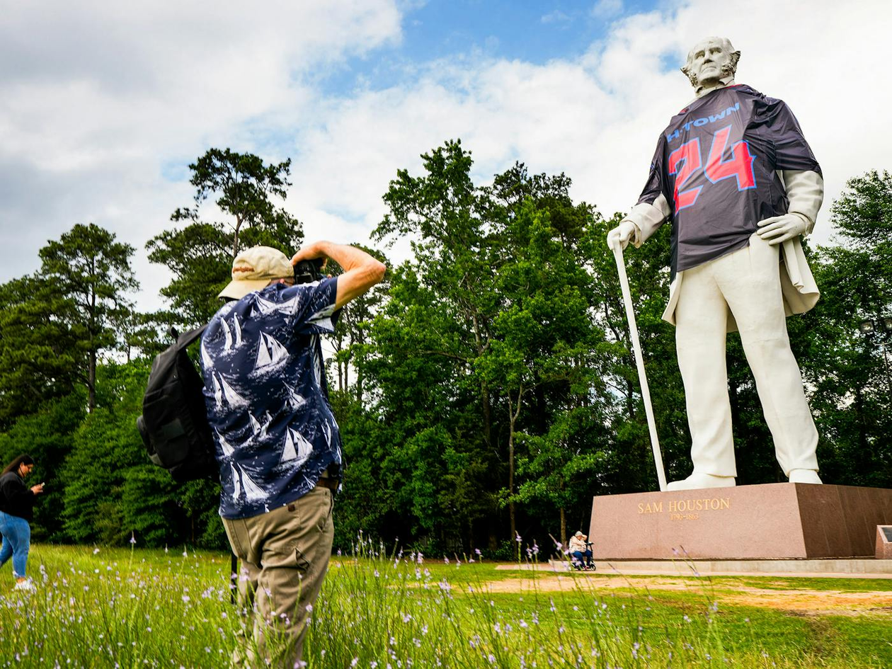
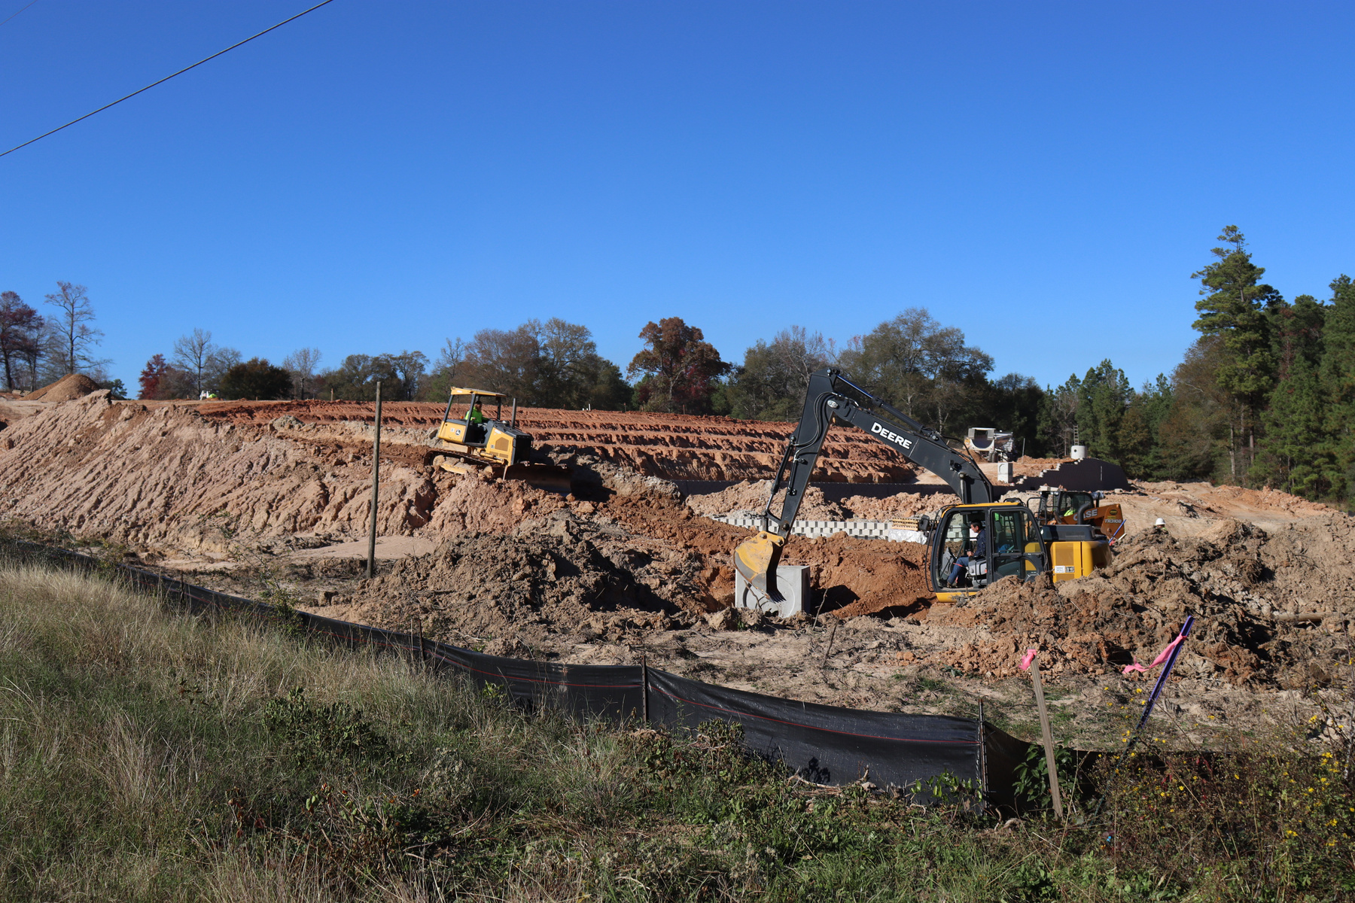
PRIVATE
DEVELOPMENT

Slide 6
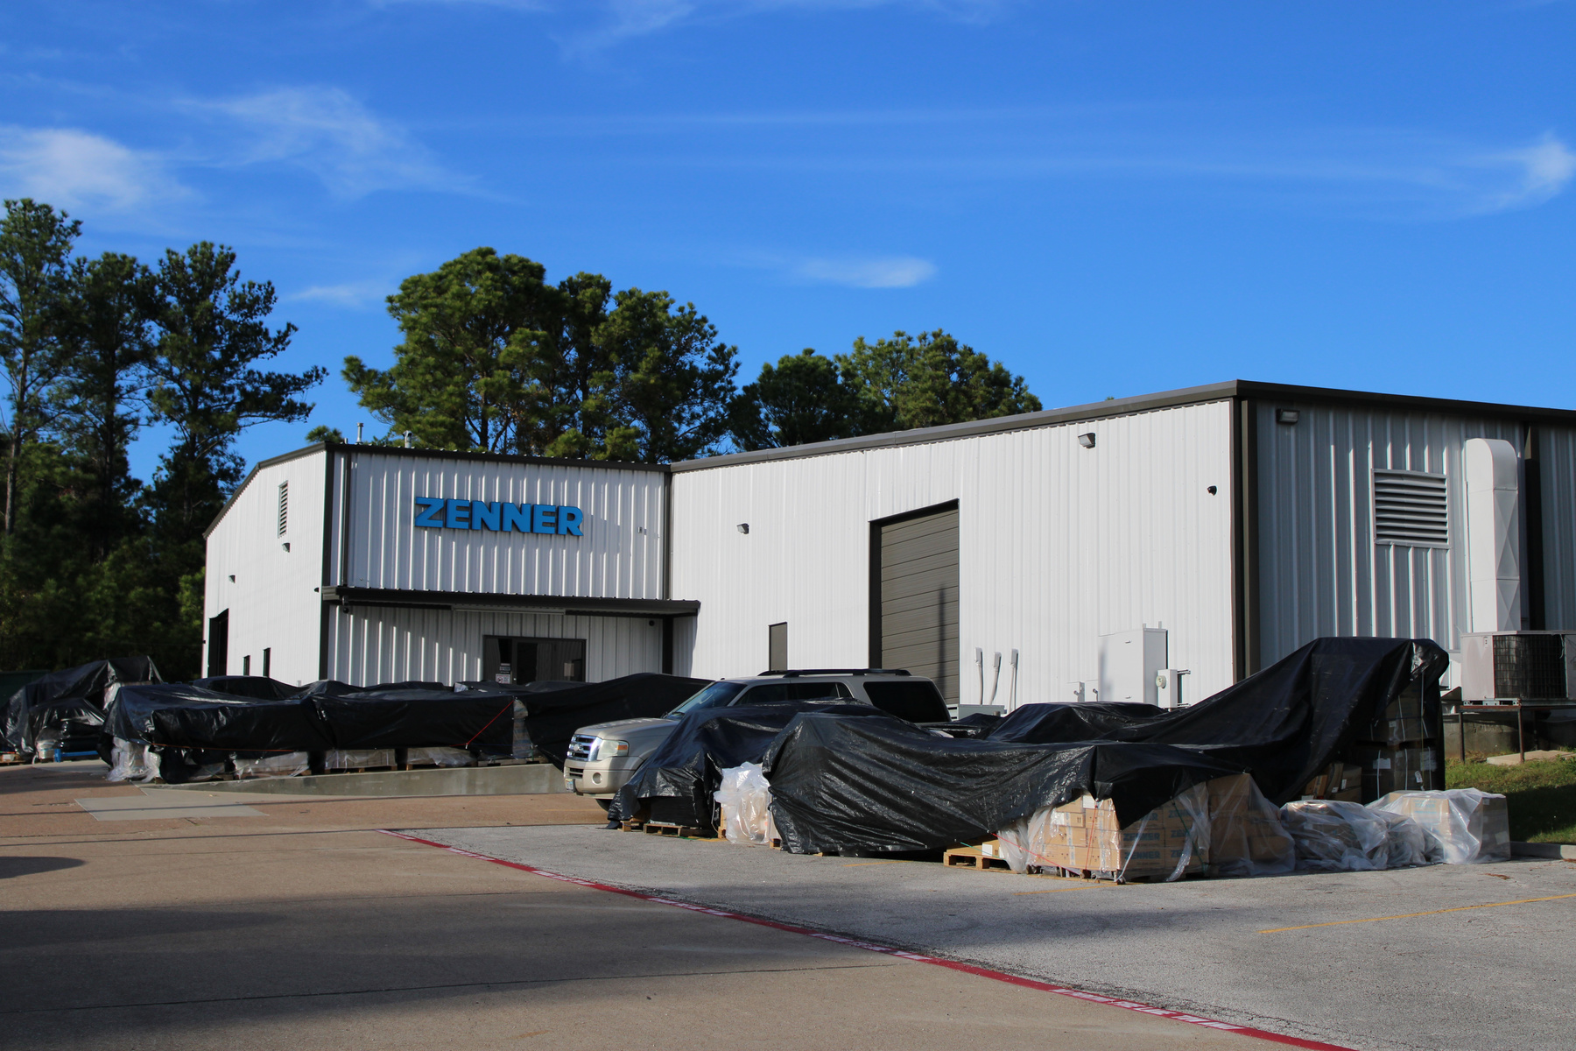
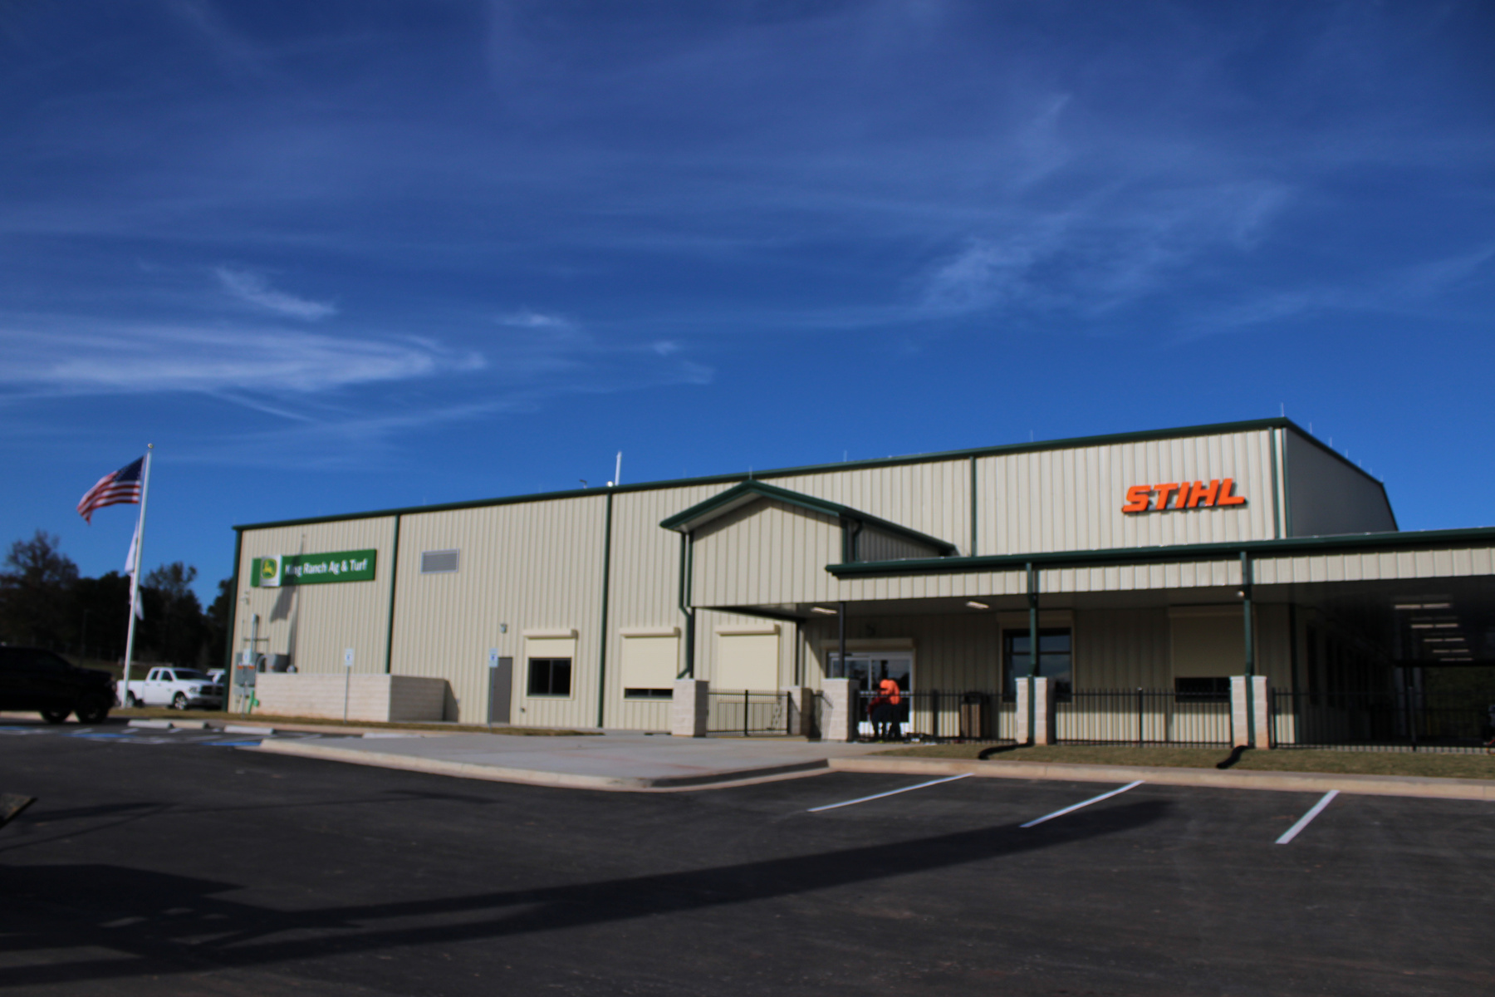
PRIVATE DEVELOPMENT
Zenner USA
John Deere King Ranch Ag & Turf
Notes:
Zenner:
1981 Quality Blvd, Huntsville, TX 77320
John Deere:
774 I-45, Huntsville, TX 77340

Slide 7
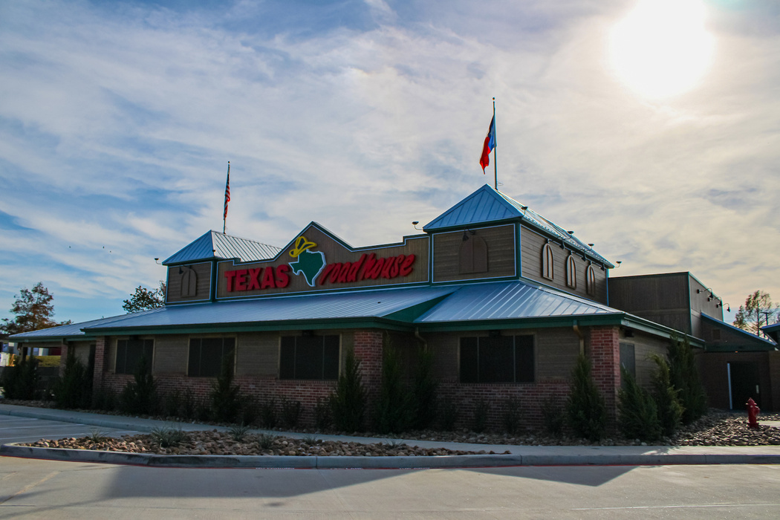
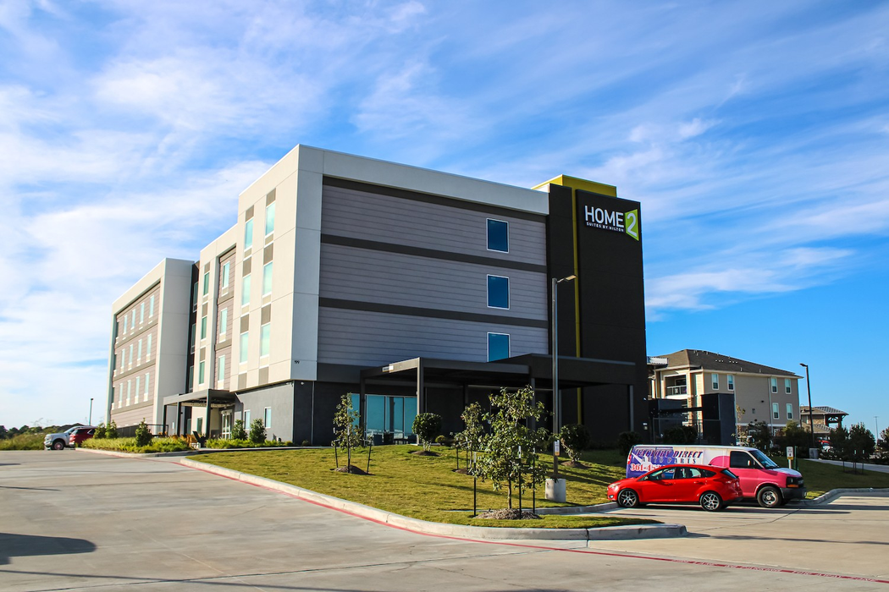
PRIVATE DEVELOPMENT
Texas Roadhouse
Home 2 Suites by Hilton
Notes:
texas roadhouse:
918 Veterans Memorial Pkwy, Huntsville, TX 77320
Home 2 suites:
199 I-45, Huntsville, TX 77340

Slide 8
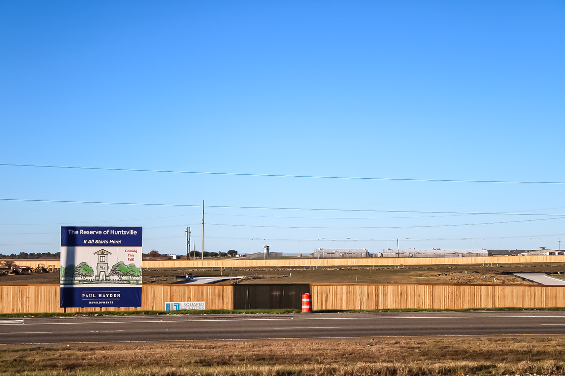
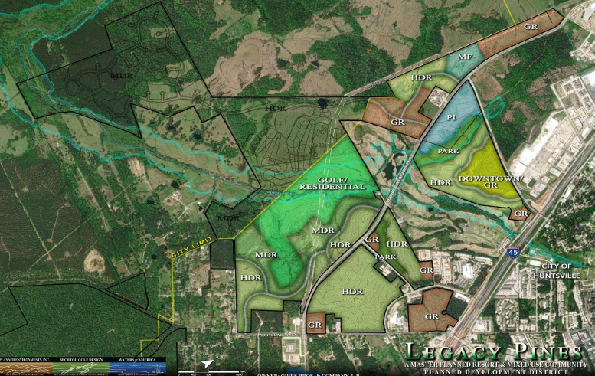
PRIVATE DEVELOPMENT
The Reserve
Legacy Pines
Notes:
The Reserve: Hwy 75
Legacy Pines: IH-45

Slide 9
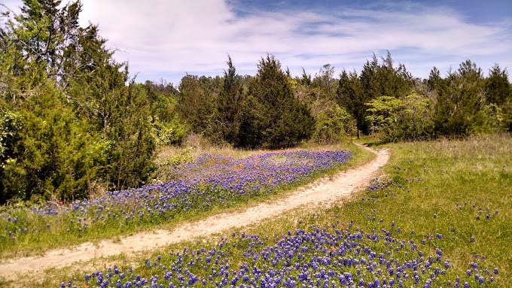

PARKS
MASTERPLAN

Slide 10
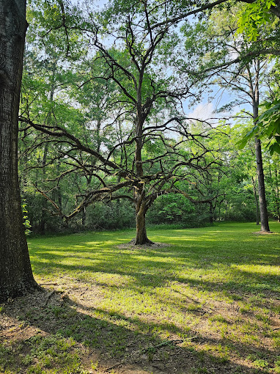
PARKS MASTERPLAN
PROCESS
Kick Off Meeting with Steering Committee: July 31, 2024
Community Input:
Three Public Workshops:
September 10, 2024
October 29, 2024
January 13, 2025
Future Town Hall Meeting: March 6, 2025 (6:00pm @MLK Community Center)
Final Action: Adoption by City Council

Slide 11

FINANCE

Slide 12
BUDGET
$94,875,085
in Total Revenues
$96,483,605
in Total Expenditures
Notes:
reasoning for why we have more expenditures than rvenues

Slide 13
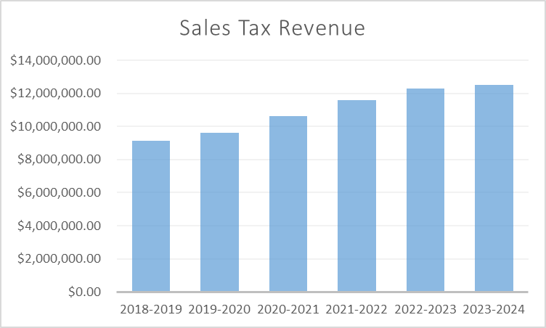
BUDGET
Total Sales Tax Revenue:
a 1.5% increase from last Fiscal Year
$12,491,994.94

Slide 14
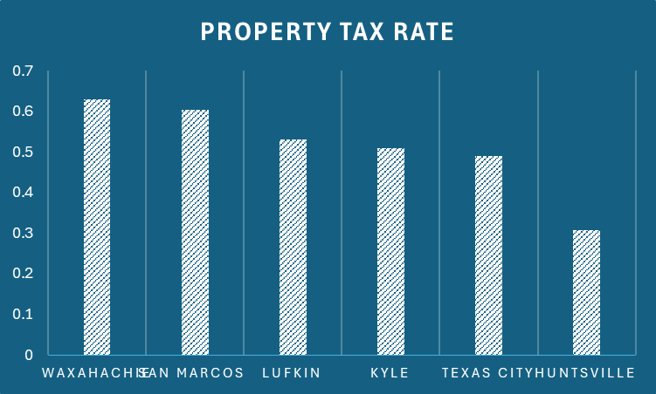
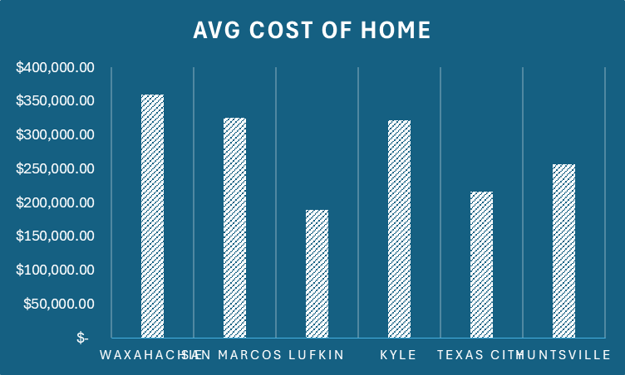
COST OF LIVING
Huntsville has a significantly lower property tax rate compared to benchmark cities, at .3074%
Waxahachie
San
Marcos
Lufkin
Kyle
Texas City
Huntsville
Huntsville has one of the lower average costs of home compared to benchmark cities, at $252,320
Waxahachie
San
Marcos
Texas
City
Huntsville
Waxahachie
Lufkin
Kyle

Slide 15
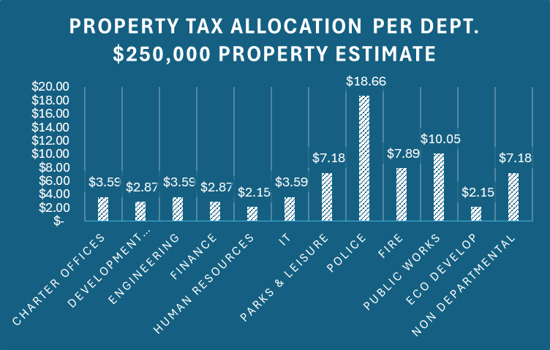
COST OF LIVING
For a home appraised at $250,000, the total monthly property tax payment is $71.77, which is allocated to various city services. Here’s how it breaks down:

Slide 16
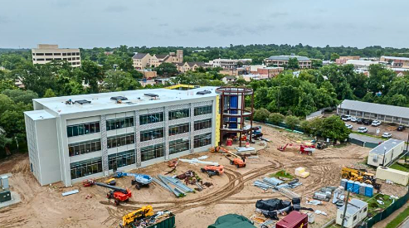
INFRASTRUCTURE

Slide 17
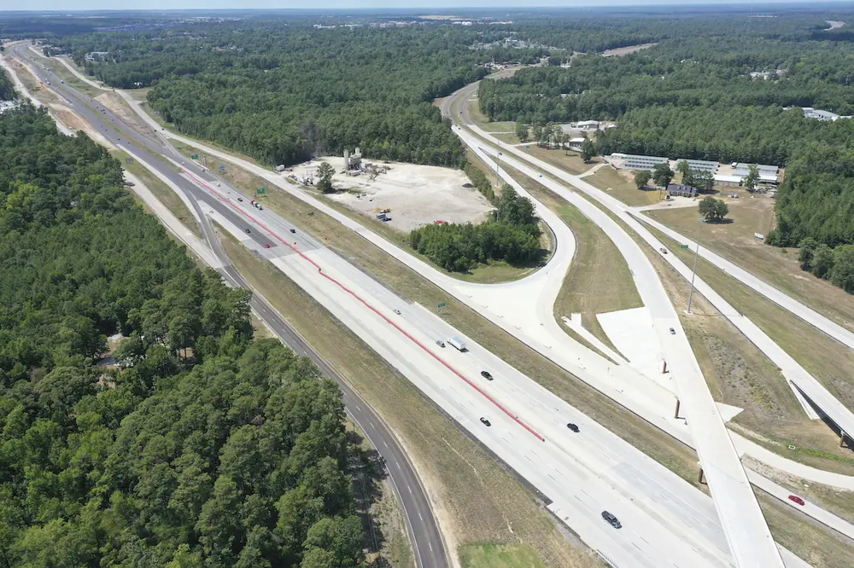
TxDOT Updates
I-45 Expansion
Phase: Milestone 3 and Milestone 4 (4A, 4B, and 4C)
Timeline:
Smither Overpass closure February 17, 2025
Bridge reopening summer 2025
Estimated Completion: Late 2027

Slide 18
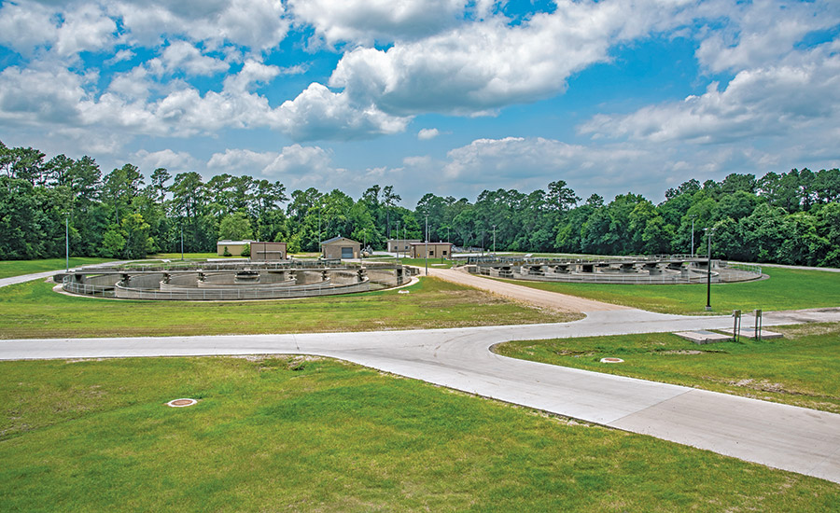
CIP Projects
McGary Creek Lift Station Expansion
Tanyard Creek Lift Station Expansion
Robinson Creek Wastewater Treatment Plant
N.B. Davidson Wastewater Treatment Plant

Slide 19
THANK YOU

